Slide 1

(Re)Creating the Past in Accessible Ways
dmayers340@gmail.com
https://debmayers.com
@debmayers24
All views are my own

Slide 2
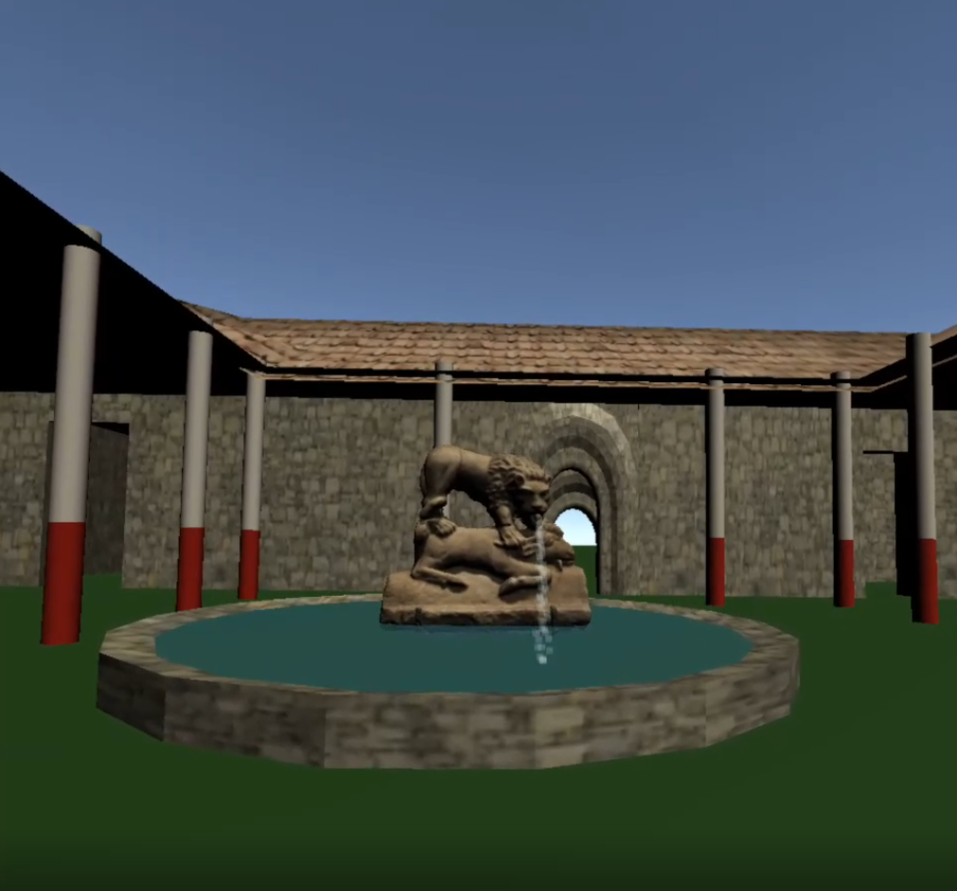
Agenda
1
About Deb
2
Brief Levelset
3
5 Things
4
Q&A

Slide 3
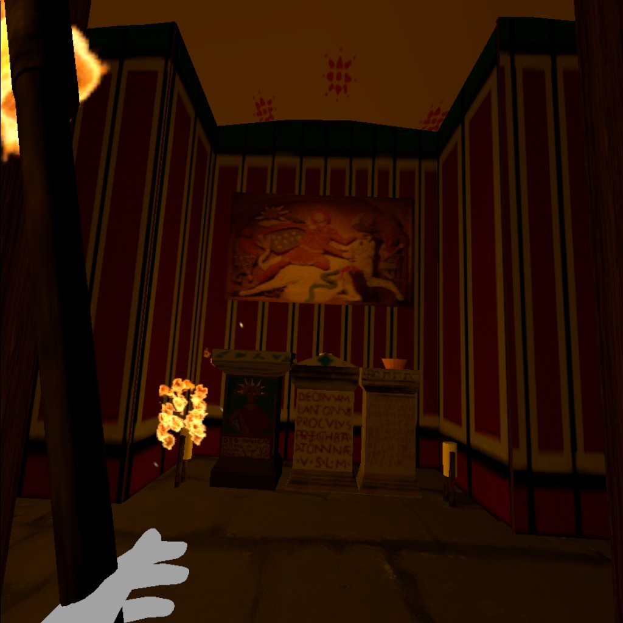
About Deb
Accessibility Technologist
6 years XR Experience
Master’s in Information Technology
Master’s in Ancient Cultures
Bachelor’s in Classical Civilization

Slide 4
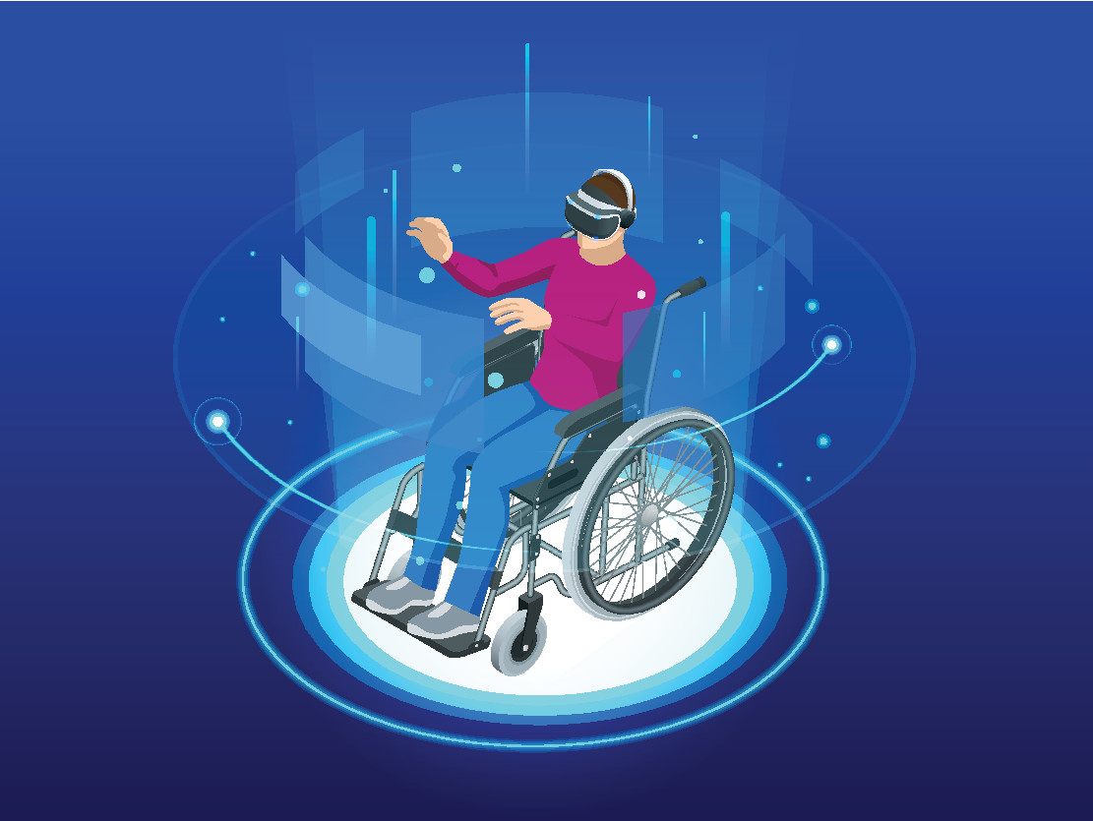
Level Set
XR is augmented, mixed, virtual reality and anything in between or beyond
Disability can occur to anyone, anytime, anywhere
Permanent, Temporary, Situational
Social Model

Slide 5
5 Things
User Control
High Level Guidelines
Change Over Time
Multiple Interpretations
Handling Unknowns

Slide 6
Our Users
Fatima:
“I love exploring new places and trying new things”
22, she/her, Sales
At a museum, quiet.
Obu:
Quote: “Data makes the world go round”
Who?: 68, he/him, Professor
Situation: Wants to learn more about the local Roman fort.
Maria:
“It is what it is.”
47, they/them, Chef
Taking night time classes to become an Egyptologist

Slide 7
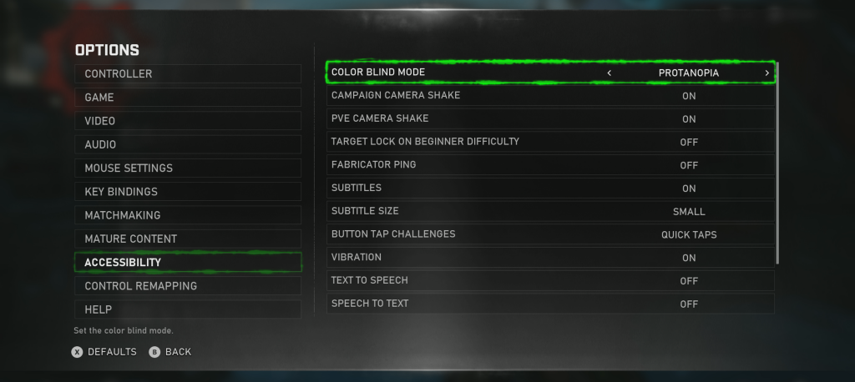
User Control
Photo: Gears5

Slide 8
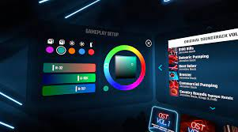
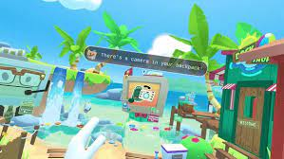
Settings
Ability to change:
  Colors
  Text Size
  Locomotion
  Seated/Standing
  Input (hand, voice, keyboard, controller)
  Verbosity of narrative
  Background noises/animations
  Captioning/Language
  Sensitivity of the camera
Photos: BeatSaber Steam Store, Owlchemy Labs Twitter

Slide 9
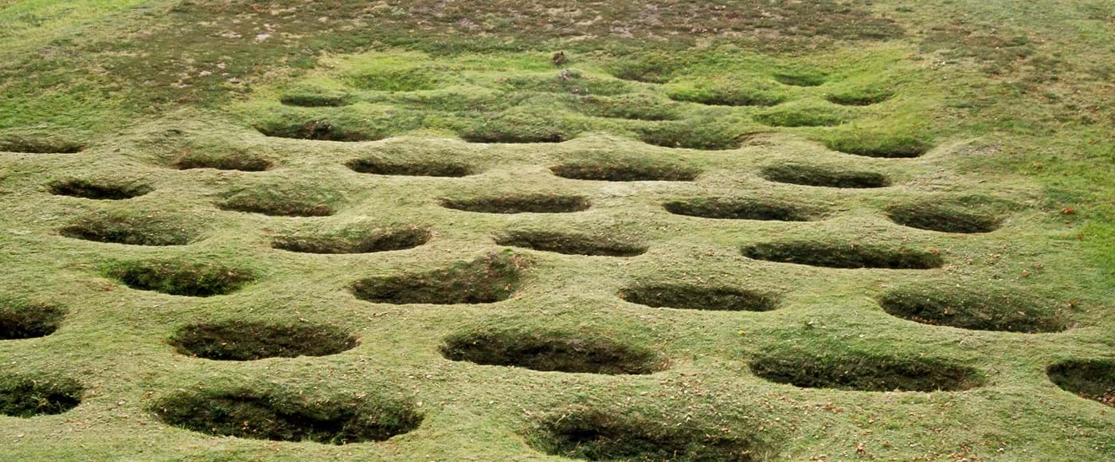
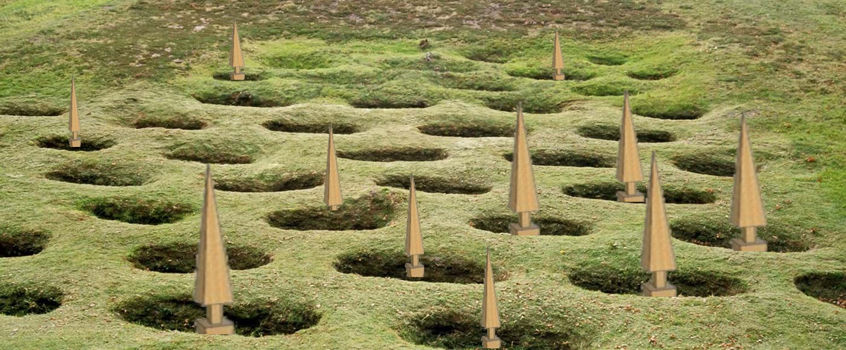
High Level Guidelines
Notes:
One of Rough Castle’s most distinctive features is the group of lilia (lily) pits to the north of the fort. Lilia pits were a defensive measure – each pit would have been fitted with a sharpened stake, pointed upright and hidden among brushwood. The pits would have served to break up attacks from the north before they reached the fort.

Slide 10

Visual Guidelines
Display text on a background, and at a suitable distance (no closer than 0.5 meters away)
Color Contrast (4.5:1)
Text Size and Typography
Limit flashing/blinking content, turn off background noises and content
Interactable objects are large enough to see/interact
Audio Descriptions
  Normal, verbose, quick, delay of when to speak
Non visual way to know when something is interactable
  Quick or long descriptions -> Ensure the important info is first

Slide 11

Audio Guidelines
Important sounds are displayed with text and/or haptics
Captions are displayed appropriately, and allow user to change
  Change font size, color, how many lines, verbosity
Sign language (hand tracking)
Transcripts are available for users (Can you use haptics for braille??)
Mono Audio and Spatial Audio
Changing the volume of background and speaking

Slide 12

Mobility Guidelines
Accurate scale of user
  Reset camera height/arm length
Seated, Standing, or Room Scale
One handed mode
  Handedness
Multiple Inputs
  Keyboard, controllers, hands, eyes, voice, switch devices, BCI
Allow a good target size (if someone’s hand shakes, can smooth that out in XR experience and have large targets for interactable objects)

Slide 13
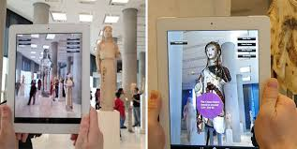
Types of Experiences to (Re)Create the Past
Contextualize Museum Objects
Virtual Environment to show objects/a site
AR archaeological digs to show where objects from the museum were found
Photo: Technological Trends in Museums

Slide 14
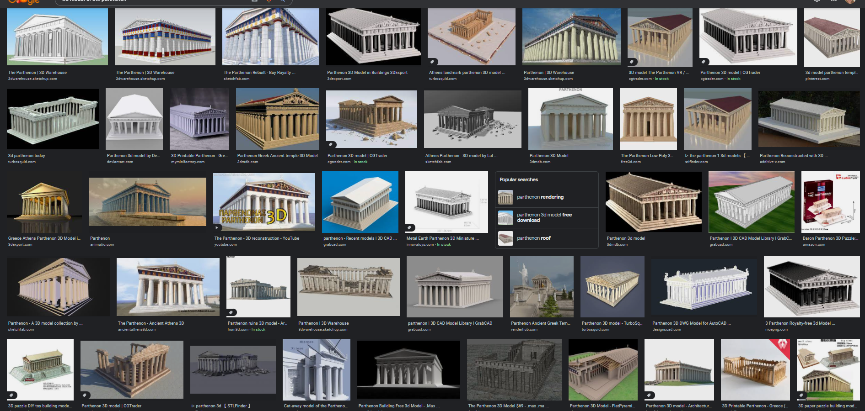
Change Over Time – The Parthenon

Slide 15
Parthenon Timeline (Hurwit, 1999)
Archaic Period 760-480 BC
Classical Period 480-322 BC
447-432 Parthenon built
438 Athena dedicated
426 Earthquake
404 Spartans stationed on Acropolis
480/79 Persian sack of Acropolis
565-560 Third temple of Athena Polias
1834 Acropolis declared archaeological site
Hellensitic Period 322-31 BC
295 – Lakhares strips Athena of gold
86 Sulla captures acropolis
117-138 AD Portrait of Hadrian in Parthenon
202 AD Julia Domna portraits in Erechtheion and Parhtenon
267 AD Herulian sack of Athens, Parthenon burns, Athena II destroyed
Late Roman Period 330 AD-582/3
360s Parthenon repaired;
450-485 Bronze Athena moved to Constantinople
582/3 Destruction of Athens by Slavs
High Byzantine Period 582/3-1204 AD
600 Parthenon converted into Church of “our lady of Athens”
1203 Mob destroys bronze Athena in Constantiple
Frankish-Florentine Period 1204-1456 AD
1206 Parthenon becomes Latin Church
Turkish Era 1456-1834
1460 Parthenon converted into a mosque
1687 Venetians besiege Acropolis, Parthenon blown up
1688+ Small mosque built on floor of roofless Parthenon
1801-05 Elgin removes Parthenon marbles
1821-22 Greeks besiege and capture acropolis
1826-27 Turks besiege and recapture acropolis
1833 Turks surrender Acropolis
360s Athena Parthenos III installed
450-485 Athena Parthenos III removed and destroyed by Christians
Notes:
Athena Polias and Persian sack of the Acropolis in the Archaic Period
The Classical Period has the Parthenon built, the Athena statue dedicated, an earthquake, and then some Spartans on the Acropolis for war
Hellenistic Period where Lakhares strips Athena of her gold, and then we get to the Roman Period where we see Sulla capturing the acropolis, a portrait of the Roman Emperor Hadrian placed in the Parthenon, portraits of Julia Domna in the Parthenon and Erechtheion. Then we have another sack of Athens, the Parthenon burns, and the second Athena sculpture is destroyed.
This brings us to the late roman period when the Parthenon is repaired, another Athena statue is put up, then the Bronze Athena sculpture is moved to Constantinople.
Then as Christianity rose, Athena Parthenos the third was removed and destroyed, and finally, we say the Destruction of Athens by Slavs merrily bringing us to the High Byzantine period when the Parthenon was converted into a church, and then 600 years later a mob destroys the Bronze Athena that was put in Constantinople.
Then in the Frankish-Florentine Period we see the Parthenon becoming a Latin Church
Before the Turkish Era where the Parthenon was then converted into a mosque, blown up, a mosque was built inside the roofless Parthenon, then Elgin steals the Parthenon marbles to bring them to the UK, the acropolis is besieged and recaptured, then surrendered, and finally in 1834 is where we end our timeline with the Acropolis being declared an archaeological site.

Slide 16
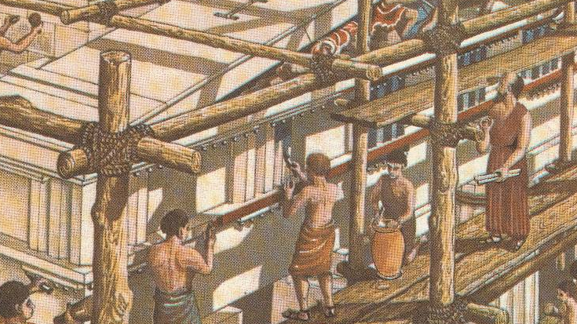
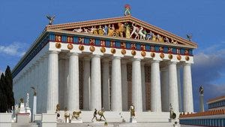
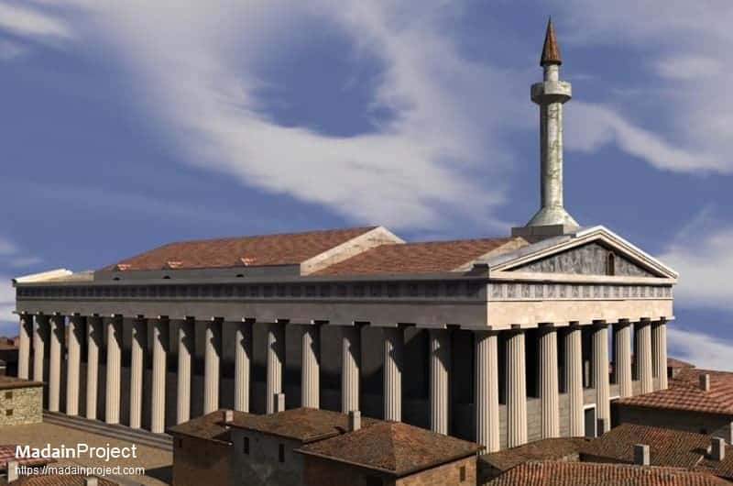
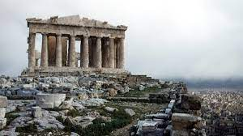
Which is more important?
Notes:
The next thing about change over time, is who is deciding which time period to represent, and why does that get more importance? It can be fairly easy to show change over time, you don’t need to remodel the whole building, can change textures.

Slide 17
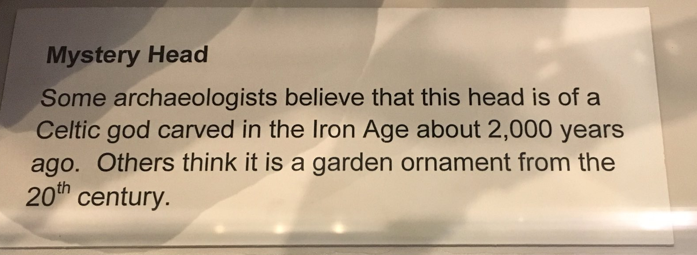
Multiple Interpretations
Photo: Ancient Tokens Twitter

Slide 18
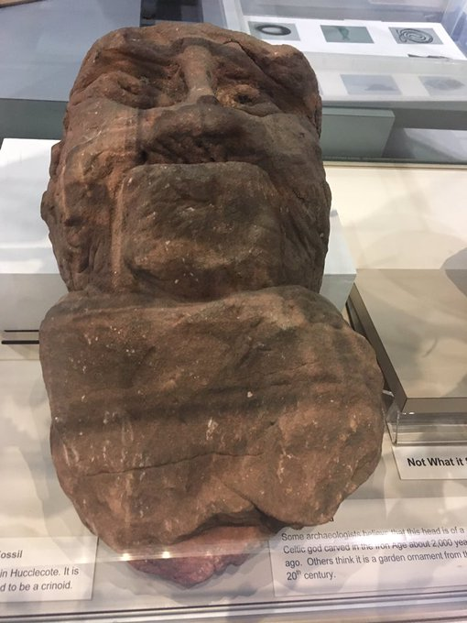
Multiple Interpretations – Celtic Head
Photos: Ancient Tokens Twitter
Notes:
So multiple interpretations are important. As Hurwit said in reference to the archaeology of the acropolis, what is one archaeologist’s hut is another’s rubbish pit. We will never know what the past was like, so we need to show our guesses, inconsistencies, and where we fill information in. Another example of this is from the North Carolina Museum of Art, they had a sculpture which was headless, the also had a head, and they put the two together and displayed it that way. One day someone came by and said, this head doesn’t fit this body, and they removed it. I love that story, because we are humans, we aren’t always going to be right, but we want to give richness to the AR or VR experience by showing multiple ways.

Slide 19
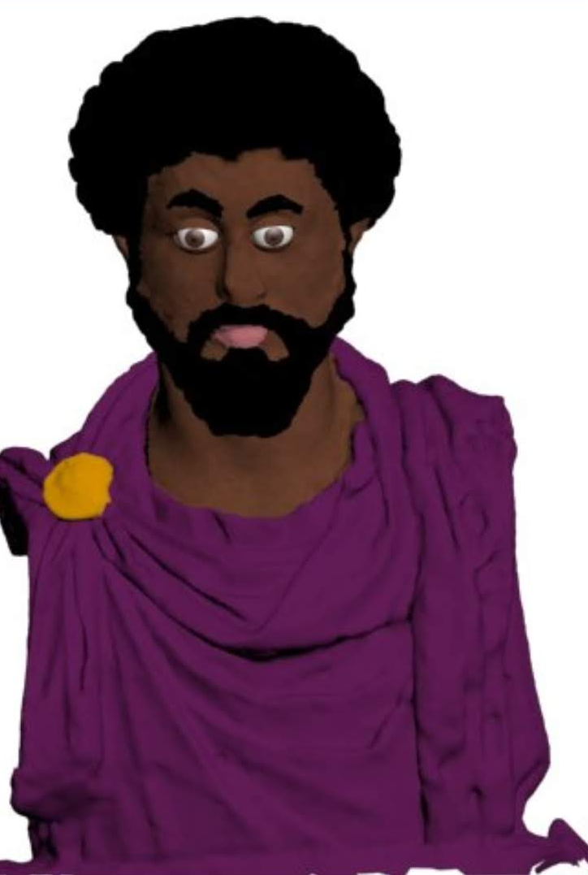
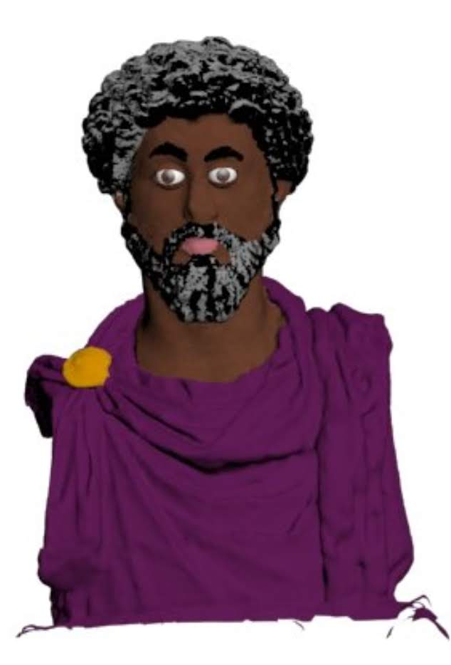
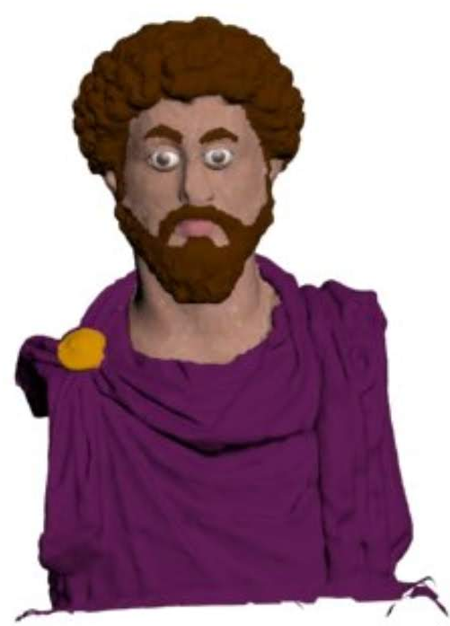
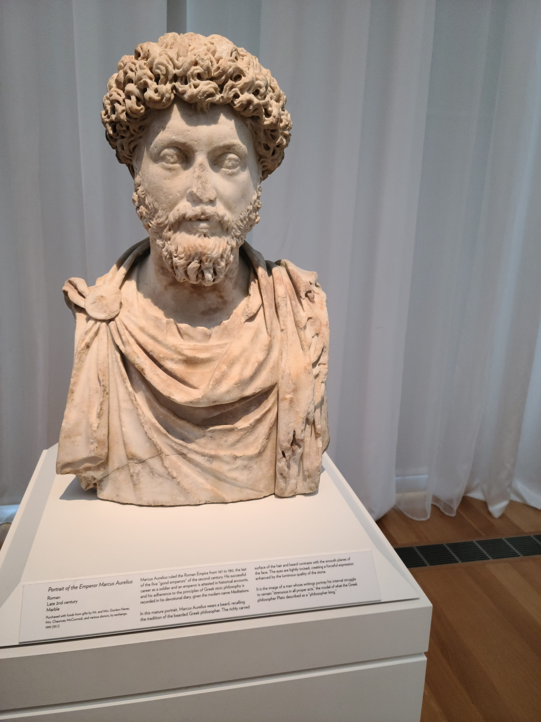
Multiple Interpretations – Marcus Aurelius

Slide 20
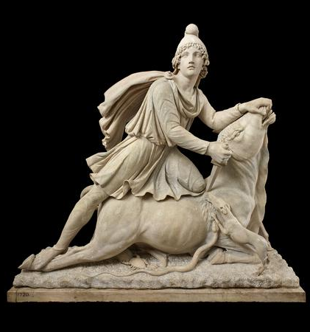
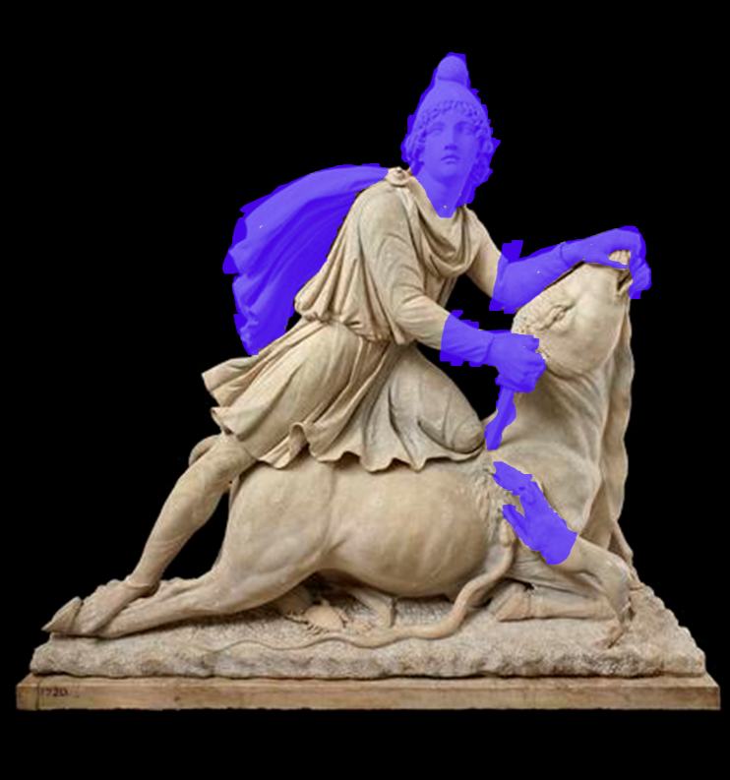
Handling Unknowns – Mithras Sculpture One
Photos: British Museum, © The Trustees of the British Museum.

Slide 21
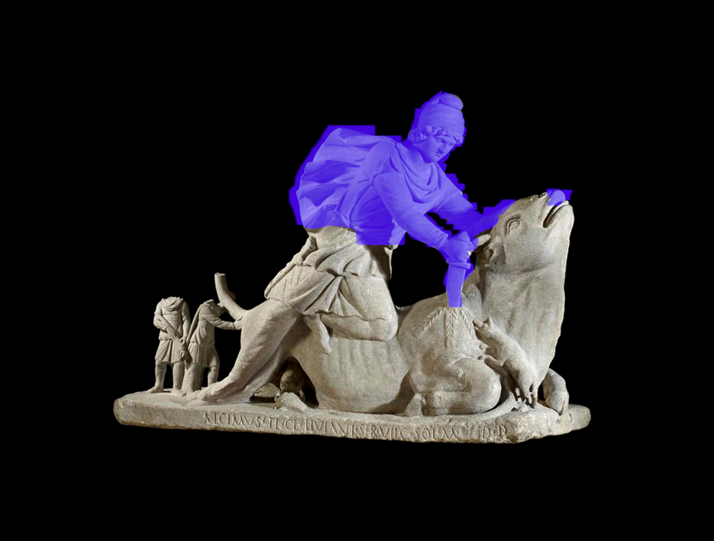
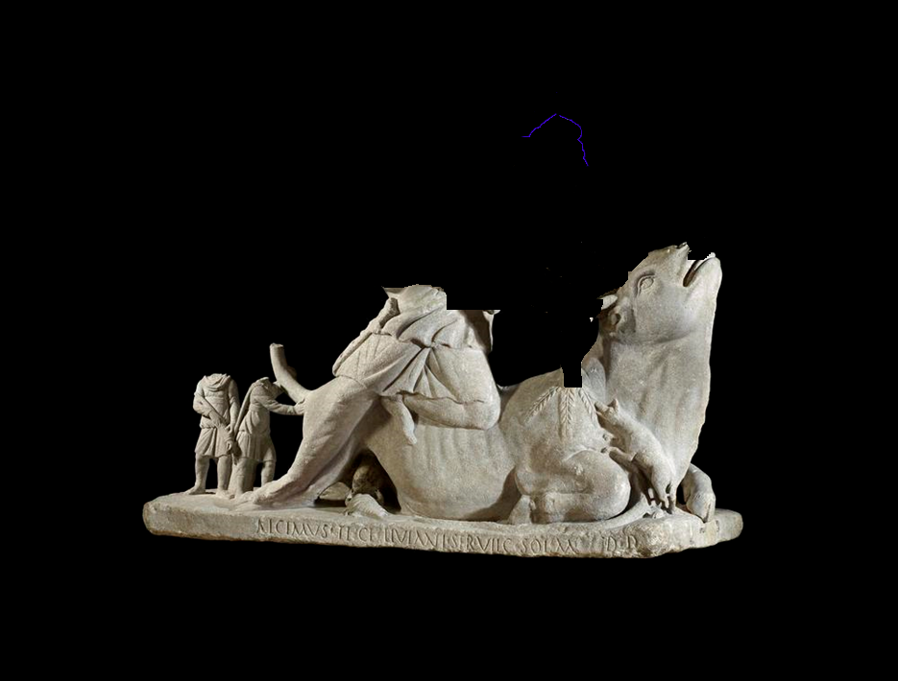
Handling Unknowns – Mithras Sculpture Two
Photos: British Museum, © The Trustees of the British Museum.

Slide 22
Examples

Slide 23
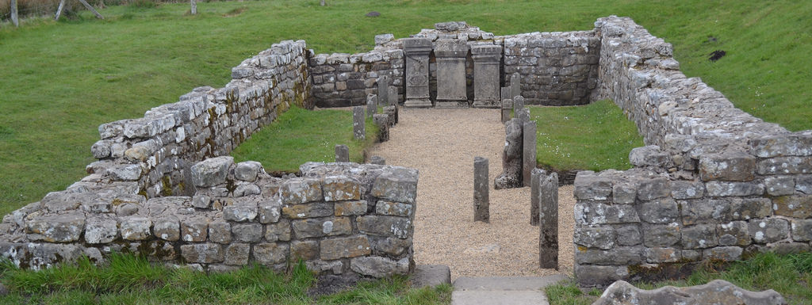
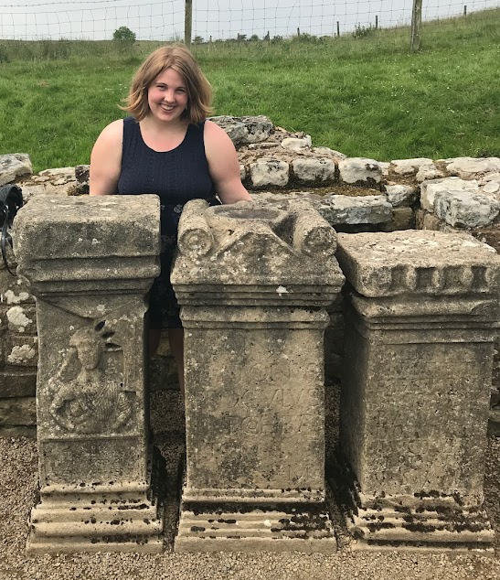
Example 1: Carrawburgh Mithraeum

Slide 24
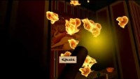
Example 1: Carrawburgh Mithraeum Considerations
Considerations:
Dark
Flickering Light
No Captions
Limited ways of interaction
  Not many haptics, visual only
No Audio Description
Shows the temple in one time period
  Was used from 3rd century AD, had 3 different layouts, destroyed c. 350
Shows my interpretation of painted iconography, but doesn’t call it out
Contains flickering light and fast camera movement. Viewer discretion is advised.

Slide 25
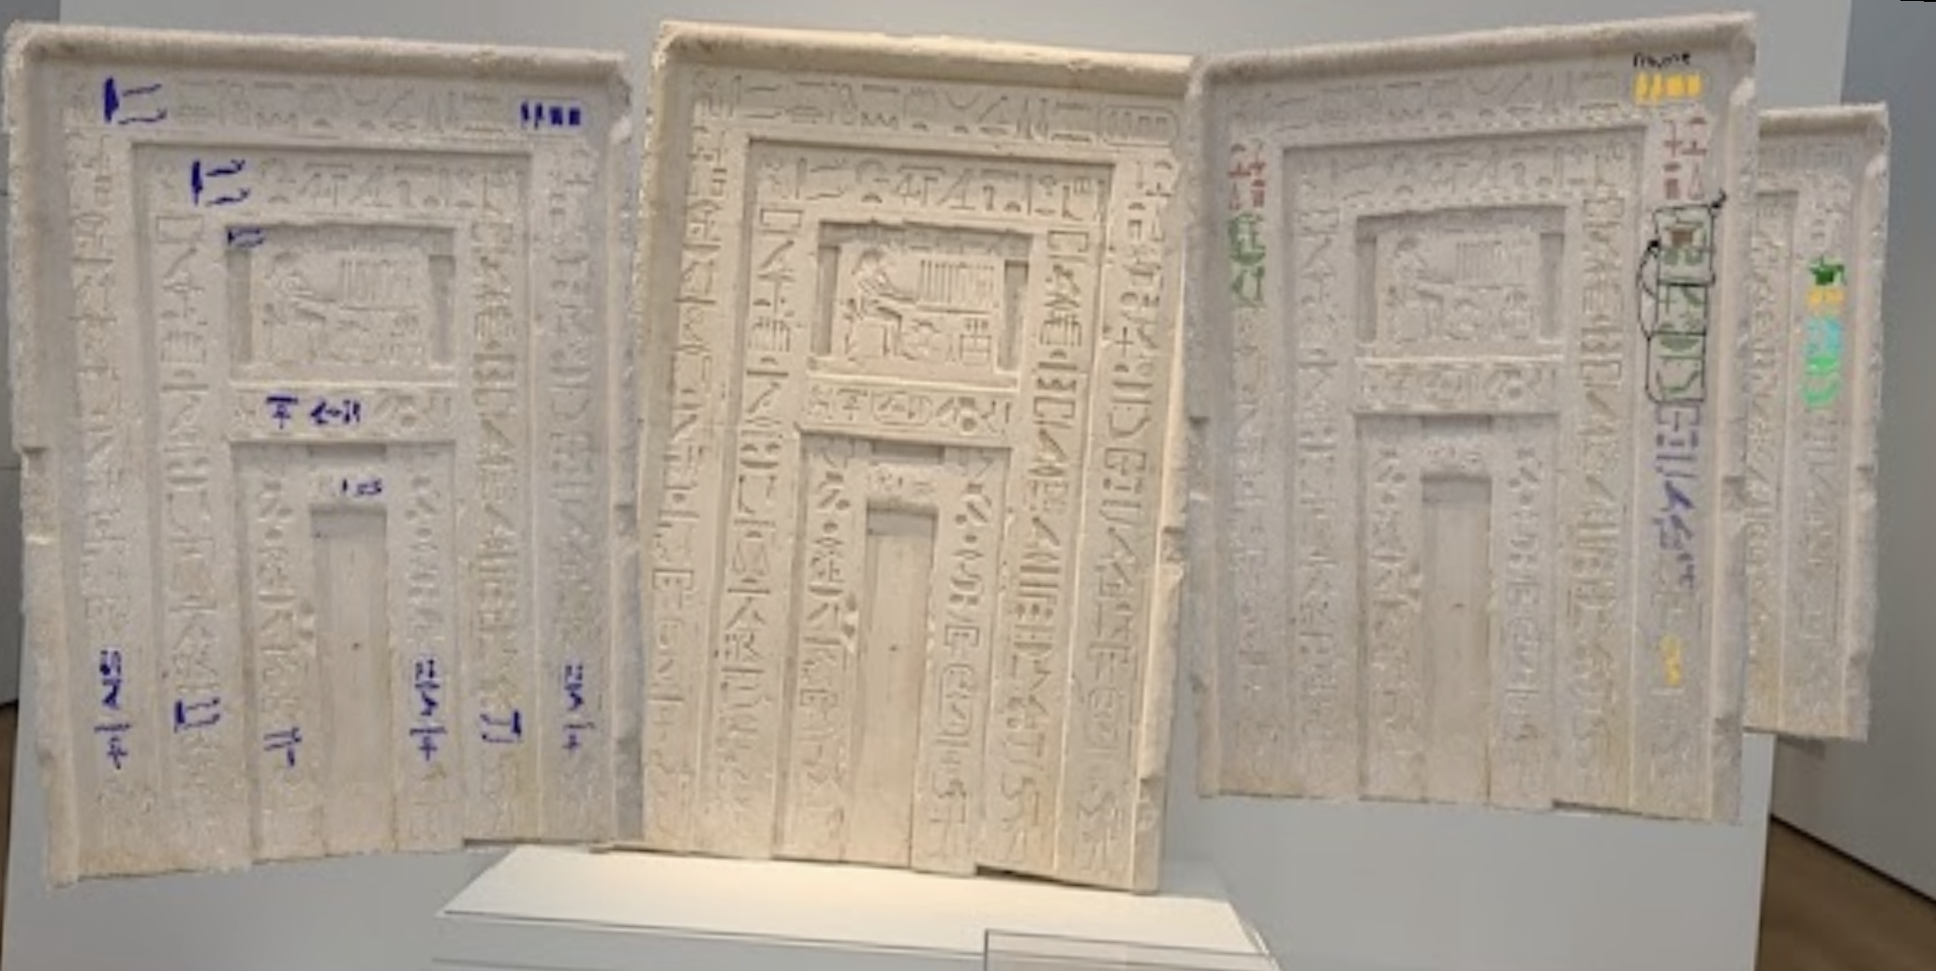
Current Case - Hieroglyphs

Slide 26
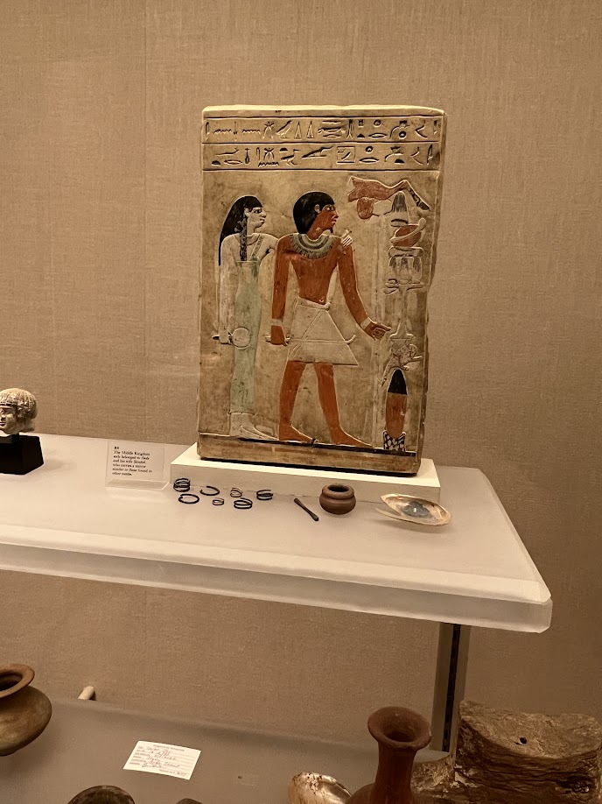
Stela of Dedu
Photo taken by Deb, Met Museum: 16.10.333
Notes:
Stela of Dedu and his wife Satsobek in the Metropoliatian Museum of Art, 18th dynasty. The placard at the museum states “This Middle Kingdom stela belonged to Dedu and his wife Sitsobek who carries a mirror similar to those found in other tombs.”
Online we have a fuller description “The two lines of inscription at the top of this rectangular stela indicate that the monument belongs to a man named Dedu, born of Seni, and his wife Sitsobek, born of Nefret. In the center of the large scene, Dedu is shown striding forward over the ground line that is painted in three colors like a wall dado. He holds a long walking stick in one hand and carries a shorter stave with an upturned end in the other. His jet black hair is short, he sports a small goatee on his chin, and he wears an ornate broad collar, bracelets, and a short kilt with a triangular front panel. Sitsobek stands to the left, placing one hand on her husband’s shoulder and holding a mirror with a papyrus-shaped handle in the other. Her long tripartite hair is as black as Dedu’s, and she is shown wearing a green close-fitting dress with a single shoulder strap. A broad collar, bracelets, and anklets complete her attire. In front of Dedu and Sitsobek are food offerings, starting at the bottom with a large pottery beaker capped with a conical stopper and placed on a low stand, which is painted in a mottled pattern perhaps to imitate diorite. Above the vessel are a plucked duck and a green table laden with loaves of bread and various cuts of meat. Although the items appear to float vertically, they are meant to be seen as arranged side by side. The low flat raised relief style seen on this stela is characteristic of the period of transition between Dynasty 11 and Dynasty 12.”
We will talk about transliteration, which is taking pictorial information and putting it in writing that we can sound out. I'll say somtehing along the lines of "The Egyptians did not use vowels so we tend to insert an e between the consonants, or when we have certain sounds an i which we use 'i', A or ' where we use an 'ah', and others like w where we use 'oo'. "

Slide 27
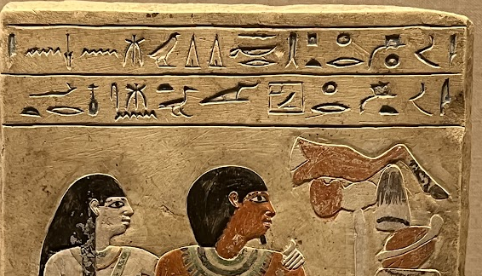
Reading Hieroglyphs Part One
Notes:
ı͗mꜣh ḫr pt
Im3h hr pth skr d(i)d(i)w ms.n sni
“imach” her pth soker, didi ew, ms n seni”
The revered one before Ptah-Sokar, Dedu, born of Seni

Slide 28
Reading Hieroglyphs Part Two
Notes:
Im3ht hr hwt-hr s3t-sbk ms(t).n nfrt
“eh mah het hair hawt her satsobek mest n neferet”
The revered one before Hathor, Satsobek, born of Neferet

Slide 29
Stela of Dedu
imAx xr ptH skr d(i)d(i)w ms.n sni
imAx xr Hwt-Hr sAtsbk ms(t).n nfrt
The revered one before Ptah Soker Dedu born of Seni
The revered one before Hathor Satsobek born of Neferet
Photo taken by Deb, Met Museum: 16.10.333
Notes:
Stela of Dedu and his wife Satsobek in the Metropoliatian Museum of Art, 18th dynasty. The placard at the museum states “This Middle Kingdom stela belonged to Dedu and his wife Sitsobek who carries a mirror similar to those found in other tombs.”
Online we have a fuller description “The two lines of inscription at the top of this rectangular stela indicate that the monument belongs to a man named Dedu, born of Seni, and his wife Sitsobek, born of Nefret. In the center of the large scene, Dedu is shown striding forward over the ground line that is painted in three colors like a wall dado. He holds a long walking stick in one hand and carries a shorter stave with an upturned end in the other. His jet black hair is short, he sports a small goatee on his chin, and he wears an ornate broad collar, bracelets, and a short kilt with a triangular front panel. Sitsobek stands to the left, placing one hand on her husband’s shoulder and holding a mirror with a papyrus-shaped handle in the other. Her long tripartite hair is as black as Dedu’s, and she is shown wearing a green close-fitting dress with a single shoulder strap. A broad collar, bracelets, and anklets complete her attire. In front of Dedu and Sitsobek are food offerings, starting at the bottom with a large pottery beaker capped with a conical stopper and placed on a low stand, which is painted in a mottled pattern perhaps to imitate diorite. Above the vessel are a plucked duck and a green table laden with loaves of bread and various cuts of meat. Although the items appear to float vertically, they are meant to be seen as arranged side by side. The low flat raised relief style seen on this stela is characteristic of the period of transition between Dynasty 11 and Dynasty 12.”

Slide 30
Summary
User Control
High Level Guidelines
Change Over Time
Multiple Interpretations
Handling Unknowns

Slide 31
References
Hurwit, J.M. 1999, The Athenian Acropolis: History, mythology, and archaeology from the Neolithic era to the present Cambridge Unviersity Press Cambrigee UK

Slide 32
Q&A
Change Over Time
Multiple Interpretations
Handling Unknowns
User Control
High Level Guidelines
dmayers340@gmail.com
https://debmayers.com
@debmayers24
All views are my own

